Slide 1
CSE4065 – Fall 2022
Computational Genomics
Genome Rearrangements
Betül Boz
betul.demiroz@marmara.edu.tr

Slide 2
Greedy Algorithm: Simple Reversal Sort – Q1
Compute the number of steps required by GreedySorting to sort the following permutation (i.e., to transform it into the identity permutation.)
+1 −7 +6 −10 +9 −8 +2 −3 +5 +4

Slide 3
Answer
+1 −7 +6 −10 +9 −8 +2 −3 +5 +4
+1 -2 +8 -9 +10 -6 +7 -3 +5 +4
+1 +2 +8 -9 +10 -6 +7 -3 +5 +4
+1 +2 +3 -7 +6 -10 +9 -8 +5 +4
+1 +2 +3 -4 -5 +8 -9 +10 -6 +7
+1 +2 +3 +4 -5 +8 -9 +10 -6 +7
+1 +2 +3 +4 +5 +8 -9 +10 -6 +7
+1 +2 +3 +4 +5 +6 -10 +9 -8 +7
+1 +2 +3 +4 +5 +6 -7 +8 -9 +10
+1 +2 +3 +4 +5 +6 +7 +8 -9 +10
+1 +2 +3 +4 +5 +6 +7 +8 +9 +10
+1 +2 +3 +4 +5 +6 +7 +8 +9 +10

Slide 4
Greedy Algorithm: Simple Reversal Sort – Q2
Compute the number of steps required by GreedySorting to sort the following permutation (i.e., to transform it into the identity permutation.)
-6 -8 -10 +4 -5 -2 +7 -3 +1 -9

Slide 5
Answer – Q2
-6 -8 -10 +4 -5 -2 +7 -3 +1 -9
-1 +3 -7 +2 +5 -4 +10 +8 +6 -9
1 +3 -7 +2 +5 -4 +10 +8 +6 -9
1 -2 +7 -3 +5 -4 +10 +8 +6 -9
1 2 +7 -3 +5 -4 +10 +8 +6 -9
1 2 3 -7 +5 -4 +10 +8 +6 -9
1 2 3 4 -5 +7 +10 +8 +6 -9
1 2 3 4 5 +7 +10 +8 +6 -9
1 2 3 4 5 -6 -8 -10 -7 -9
1 2 3 4 5 6 -8 -10 -7 -9
1 2 3 4 5 6 7 +10 +8 -9
1 2 3 4 5 6 7 -8 -10 -9
1 2 3 4 5 6 7 8 -10 -9
1 2 3 4 5 6 7 8 9 10

Slide 6
Greedy Break Point Reversal Sort: Q3
Apply the greedy break point reversal sort to the given permutation
π = 2 3 1 4 6 5
π = 1 9 3 4 7 8 2 6 5

Slide 7
Answer – Q3.a
0 | 2 3 | 1 | 4 | 6 5 | 7 b(π) = 5
0 1 | 3 2 | 4 | 6 5 | 7 b(π) = 4
0 1 2 3 4 | 6 5 | 7 b(π) = 2
0 1 2 3 4 5 6 7 b(π) = 0

Slide 8
Answer – Q3.b
0 1 | 9 | 3 4 | 7 8 | 2 | 6 5 | 10 b(π) = 6
0 1 | 9 8 7 | 4 3 2 | 6 5 | 10 b(π) = 4
0 1 2 3 4 | 7 8 9 | 6 5 | 10 b(π) = 3
0 1 2 3 4 5 6 | 9 8 7 | 10 b(π) = 2
0 1 2 3 4 5 6 7 8 9 10 b(π) = 0

Slide 9
Improved Greedy Break Point Reversal Sort: Q4
Apply the improved greedy break point reversal sort to the given permutation
π = 1 4 6 5 7 8 3 2
π = 1 9 4 3 7 8 2 5 6

Slide 10
Answer – Q4.a
0 1 | 4 | 6 5 | 7 8 | 3 2 | 9 b(π) = 5
0 1 2 3 | 8 7 | 5 6 | 4 | 9 b(π) = 4
0 1 2 3 | 8 7 6 5 4 | 9 b(π) = 2
0 1 2 3 4 5 6 7 8 9 b(π) = 0

Slide 11
Answer – 4.b
0 1 | 9 | 4 3 | 7 8 | 2 | 5 6 | 10
0 1 2 | 8 7 | 3 4 | 9 | 5 6 | 10
0 1 2 | 8 7 6 5 | 9 | 4 3 |10
0 1 2 3 4 | 9 | 5 6 7 8 | 10
0 1 2 3 4 | 9 8 7 6 5 | 10
0 1 2 3 4 5 6 7 8 9 10

Slide 12
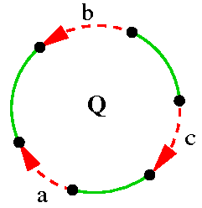
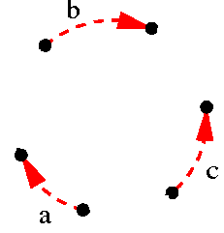
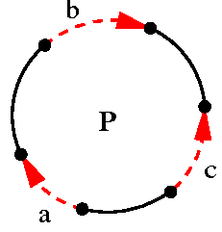
Q5) Transform P into Q
P = +a +b -c
Q = +a -b +c

Slide 13
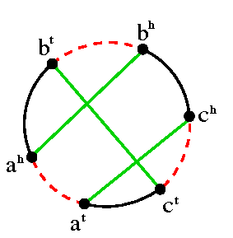
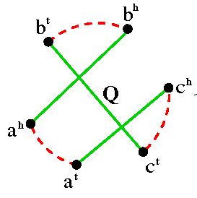
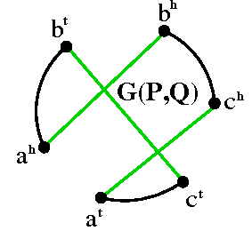
BreakpointGraph(P,Q)

Slide 14
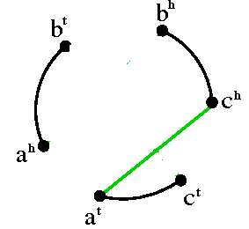
G(P, Q) to G(Q, Q)

Slide 15
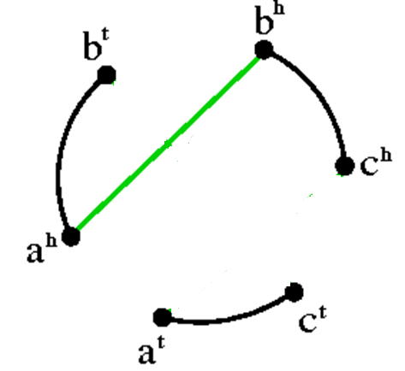
G(P, Q) to G(Q, Q)

Slide 16
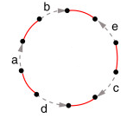
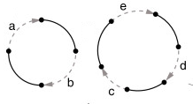
Q6) Transform P into Q
P = +a +b –e +c -d
Q = (+a +b) (+e +d +c)

Slide 17
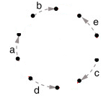
Q6) Transform P into Q
Q = (+a +b) (+e +d +c)

Slide 18
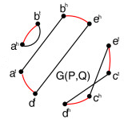
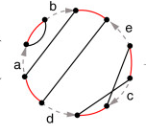
BreakpointGraph(P,Q)

Slide 19
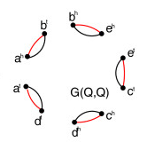
G(P, Q) to G(Q, Q)

Slide 20
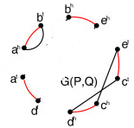
G(P, Q) to G(Q, Q)

Slide 21
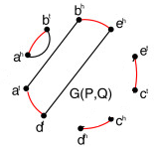
G(P, Q) to G(Q, Q)

